Slide 1
attendance
The best
In history
Will Tran

Slide 2
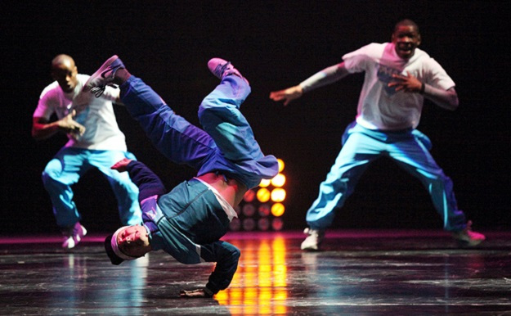
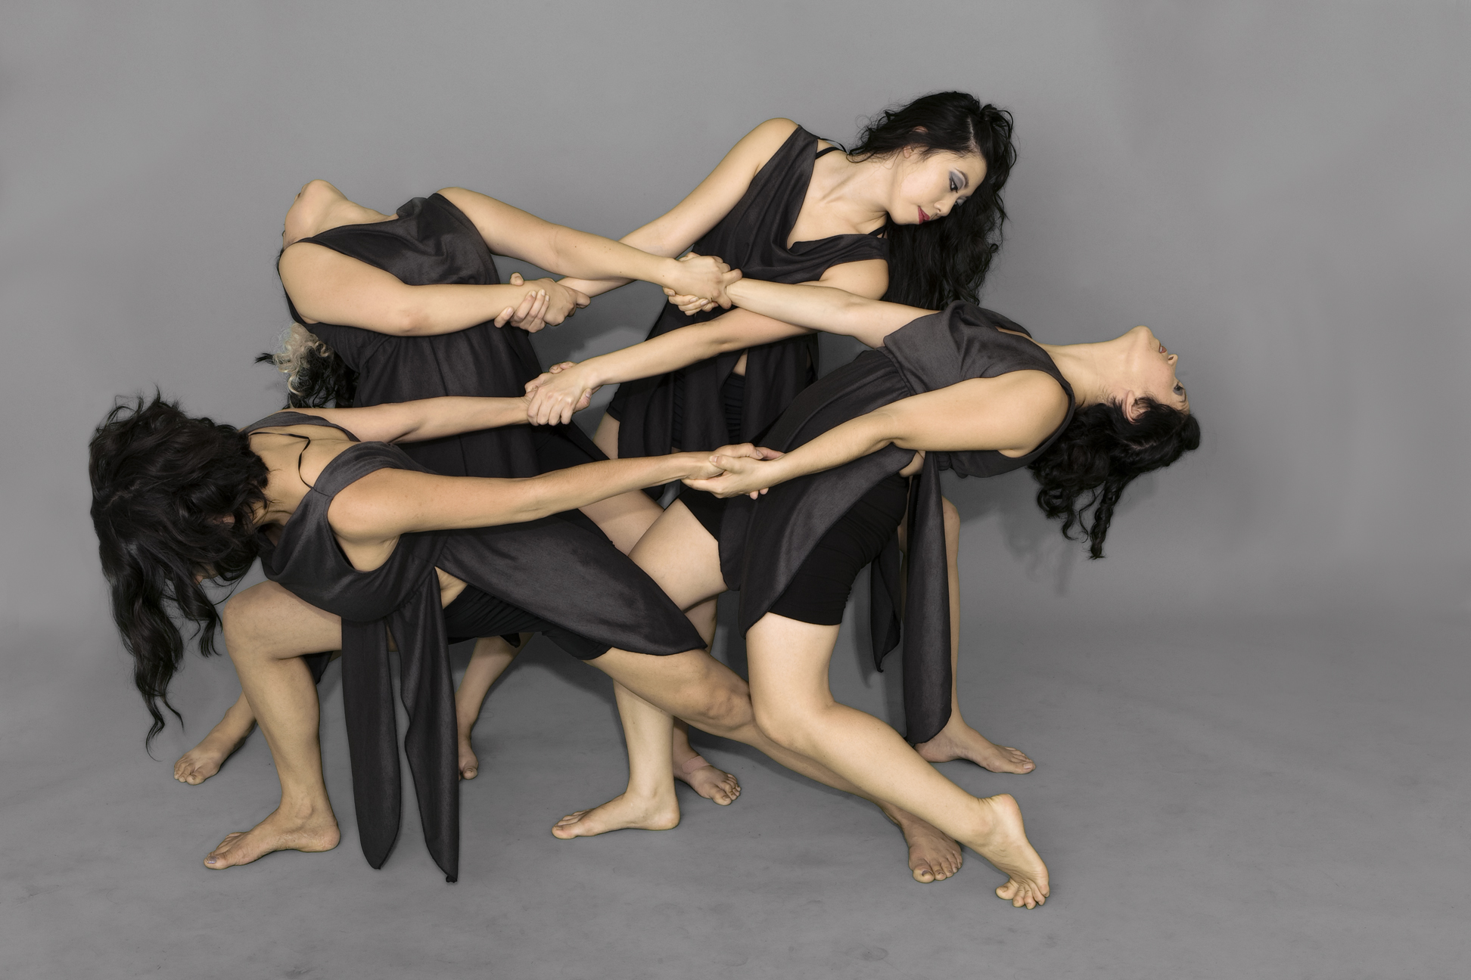
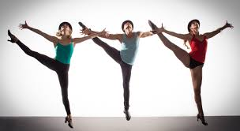
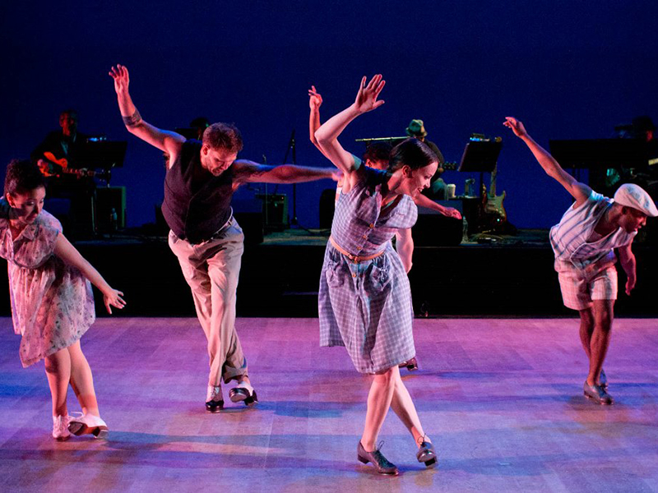
mix then match
modern
tap
jazz
hip hop
ballet

Slide 3
hip hop
-Also known as street dancing
-Began in the late 1960s
-Originated in America
-Started in New York and made its way to California
-Influenced by jazz dancing, tap dancing, martial arts, and gymnastics

Slide 4
modern
-Began in the late 19th and early 20th centuries
-Originated in Germany and America
-Breaking away from ballet technique and attire

Slide 5
jazz
-Began in the early 20th century
-Originated in Africa and then brought over to America as slave dances
-At the time, was done to jazz music
-1930s-1960s, transferred from street dancing to theatrical dancing

Slide 6
ballet
-Began in the 15th and 16th century
-Originated in Italian Renaissance and brought to France and Russia
-In France and Russia, they made it more into a theatre performance
-Dancing with elegance and grace

Slide 7
tap
-Began in the mid 1800s
-Originated in America
-Influenced by African tribal dancing, Irish jigs, and percussion music
-Two types of tap dance: Rhythm tap and Broadway tap
-Making sounds with the metal on the bottom of shoes

Slide 8
dance
You later

